Slide 1
High Priced Subprime Mortgages

Slide 2
Objective:
Definition of Higher Priced Subprime
1st Lien coupon was originated 3% over the treasury rate
2nd Lien coupon was originated 5% over the treasury rate
The ability to determine subprime loans can assess the overall health of the housing market
This work addresses the population that were generating High Priced Subprime loans
Were more minorities taking subprime loans?
Were subprime loans generated to lower income borrowers?
Was higher growth areas generating more subprime loans?

Slide 3
Predictors
Variable | Definition
Income Quintile | Stated Income from LAR’s data: Dummy for borrower falling below quintile income level / Total housing units (State)
Equifax Low FICO | Percentage of population in County below 660
Black | # of Originations by Black in County / Total Housing Units (State)
Hispanic | # of Originations by Hispanic in County / Total Housing Units (State)
Ownership | # Total Owner Occupied in County / Total Housing Units (State)
Weighting used, County Total Housing Units / State Level Total Housing Units

Slide 4
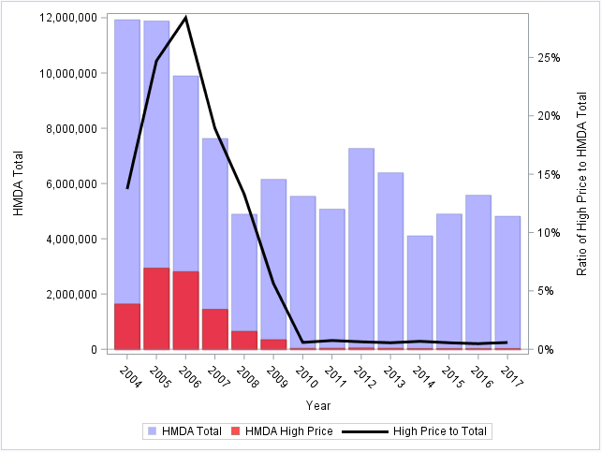
Population Characteristics
Ratio of High Priced Subprime to Total Originations
Lending Changes
Structural Break

Slide 5
Main Results
** Significant at the 5% level

Slide 6
Main Results
2004 to 2009:
Borrowers falling in lower income quintiles compared to top quintile have a higher rate of subprime mortgages
Minorities have a higher rate of subprime mortgages
More lending results in a higher rate of subprime mortgages
2010 Forward:
Income quintiles are inconclusive for the subprime definition
Minorities are inconclusive for the subprime definition
More lending still results in a higher rate of subprime mortgages, however the effect is drastically reduced

Slide 7
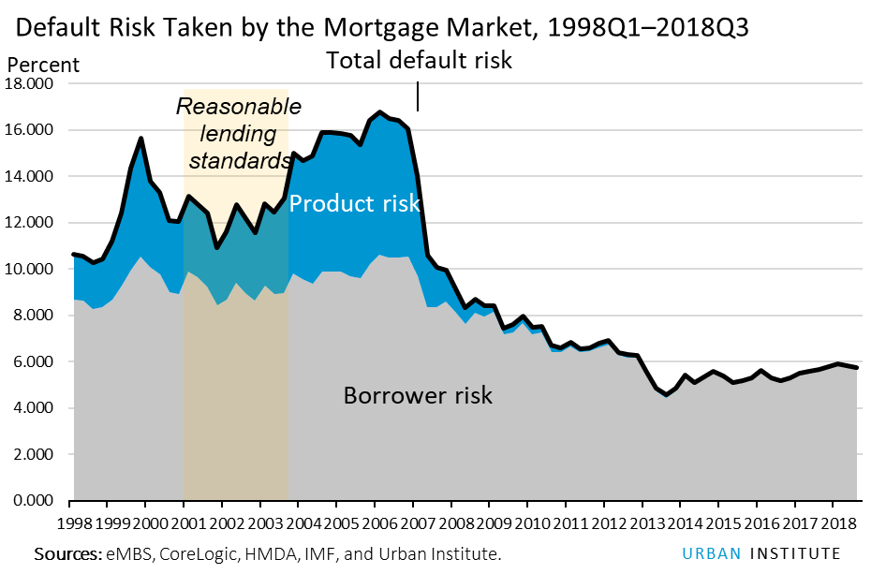
Why Did This Happen???
Higher Rate of Riskier Products and Borrower Risk
Before Great Recession
After Great Recession
https://www.urban.org/sites/default/files/publication/98669/housing_finance_at_a_glance_a_monthly_chartbook_june_2018_0.pdf

Slide 8
Why Did This Happen???
Clearly there is a structural break in the data
Mainly this is due to the change in lending standards
High Priced Subprime and the Yield Curve
The Yield Curve simply shows the cost of money between investments in the long term and short term
Example, investing in a 10 year bond results in higher return versus a 2 year bond (Normal)
Example, investing in a 10 year bond results in the same return as a 2 year bond (Flat)
The rate spread used in the data accounts for the Yield Curve.
Avery, Brevoort and Canner, 2007 show that 13% of Higher Priced Subprime loans were classified as such solely due to the flattening of the yield curve

Slide 9
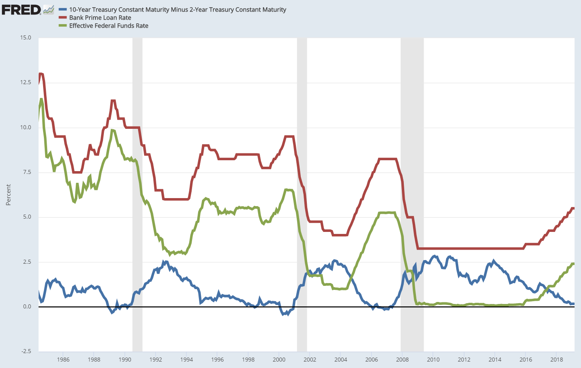
How do we fix this???
Flattening of the Yield Curve
Rates went way down

Slide 10
Future Work
Larger Extension
It is now 2018, we know investors in the past that crippled the mortgage market (Countrywide, Golden West, WFF, etc…)
Create a new subprime definition from known investors that were heavy originators of Subprime mortgages prior to and during the financial crisis.
Apply the new definition to future originations (2010-2017) to understand how the characteristics of the past compare to more recent originations.
Additional predictors from FRED Data Base.

